Slide 1
Soongsil University
School of Computing & Software
Soongsil Coin
Team Chainerator(PABCon)
신재철 (컴퓨터학부)
홍상원 (컴퓨터학부)
정구익 (소프트웨어학부)
하현수 (소프트웨어학부)
Notes:
숭실 코인 프로젝트에 대해 발표를 하도록 하겠습니다. Chainerator 팀은 신재철, 홍상원, 정구익, 하현수로 구성되어 있습니다.

Slide 2
INDEX
Introduction
Main subject
Conclusion
Project outline
Motivation
Researching
Project scenario
System structure
Flow chart
Demo
Roadmap
Expectation effect
Challenges
Notes:
발표 내용은 다음과 같이 구성하였습니다.

Slide 3
Introduction

Slide 4
Motivation
Too Heavy
Blockchain Core’s Code is Too heavy to handling
Bitcoin Core : Approximately 100K Lines! Bytecoin Previous Version : 600K Lines!
So, We have to Develop lightweight blockchain.
Small Community
Blockchain Core is very difficult and complex, And
There is no framework for Start-Level Core Developer. So, we want to make Blockchain core framework such as Start-Kit.
Inflexible
Most Blockchain Project is very inflexible. Changing Consensus or Protocol is very hard because of Inflexible of Architecture
Notes:
저희 팀은 현재 블록체인 코어의 문제점을 발견하였습니다.

Slide 5



Project outline
Modularization
Open Source
Lightweight Source Code
Blockchain Core
Function Modularization
Deploying Open Source
For Blockchain Core Developer And Getting Some Contribution
Develop Lightweight Blockchain Core
Notes:
그래서 저희 팀은 현재 블록체인 코어의 문제점을 해결하기 위해 모듈화되어 있고 오픈소스화되어 커뮤니티를 형성하고 가벼운 소스코드를 지향하는 플랙서블한 블록체인 코어 프레임워크를 개발하기로 기획하였습니다.

Slide 6



Project outline
Modularization
Open Source
Lightweight Source Code
Researching for Blockchain Core
Function Modularization
Deploying Open Source on Github
For Blockchain Core Developer And Getting Some Contribution
Develop Lightweight Blockchain Core with JavaScript
Notes:
그리고 저희가 각 세 가지 요구사항을 해결하기 위해 다음과 같은 해결책으로 접근하였습니다. 먼저 자바스크립트를 이용하여 불필요한 소스코드를 제거하고 가벼운 블록체인 코어를 개발하는 것이었습니다.

Slide 7
Main subject

Slide 8


Researching – Blockchain
Bitcoin
Litecoin
Bitcoin is the first Blockchain based Cryptocurrency, and it is open source.
It is difficult to modify flexibly as constant and variable are dependent by coin. Also, It is difficult to analyze source code because of poor modularization.
Litecoin is relatively easy to modify the blockchain property such as maximum amount of coin, hashing method, block size, and block creating time by removing restriction of modification in Bitcoin

Slide 9

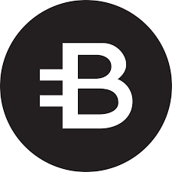
Researching – Blockchain
Peercoin
Bytecoin
Peercoin is based on Bitcoin and changed Proof-of-Work(POW), which is a consensus algorithm to Proof-of-Stake(POS)
Existing code and new Peercoin codes are mixed in a disorderly. so, It is still lacking in flexibility and modularization to using
Bytecoin is the first independent Blockchain to have nothing to do with the Bitcoin.
Created with its own Blockchain Core technology called Cryptonote, It is relatively easy to modify the value of the Blockchain Properties, but the source code extensive and poorly modular

Slide 10
Researching – Consensus algorithm
PoW
PoS
DPoS
Proof Of Work
Proof Of Stake
Delegated Proof of Stake

Slide 11
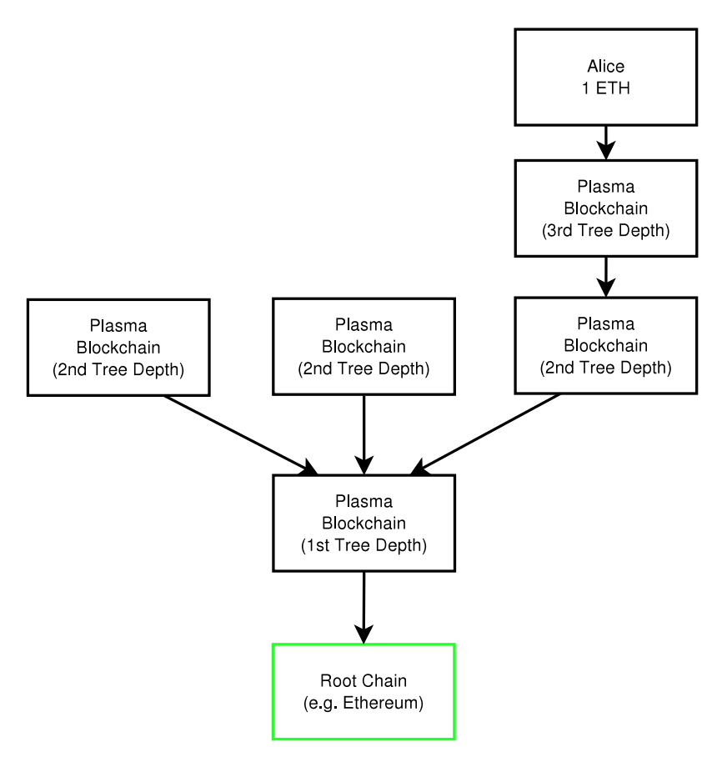
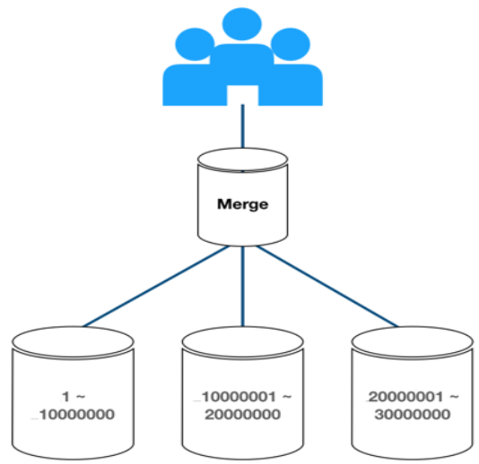
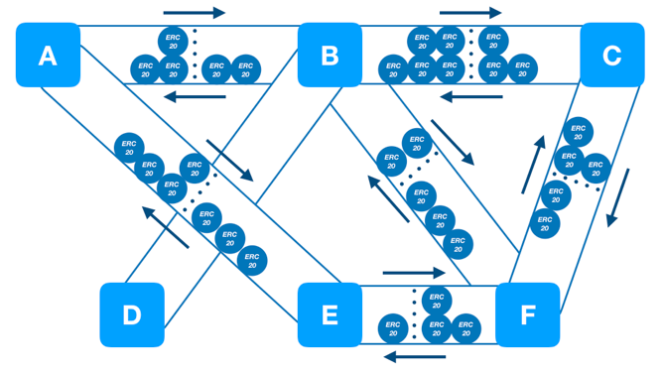
Researching : Paper
Raiden Network
Plasma
Sharding
Sangwon Hong, Jaecheol Shin, Sangjun Lee, “Technology Trends for Enhancing Ethereum Blockchain Performance”, KIISE, pp.1943-1944, 2018.

Slide 12
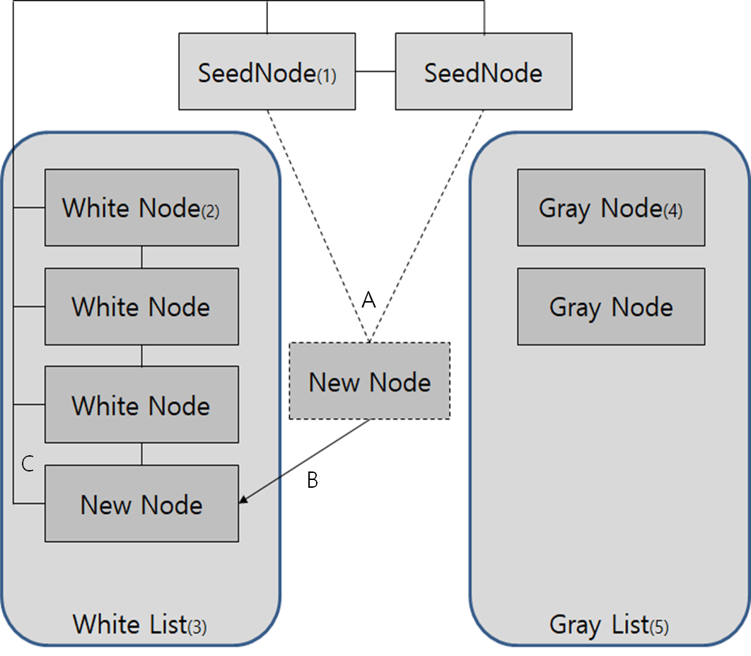
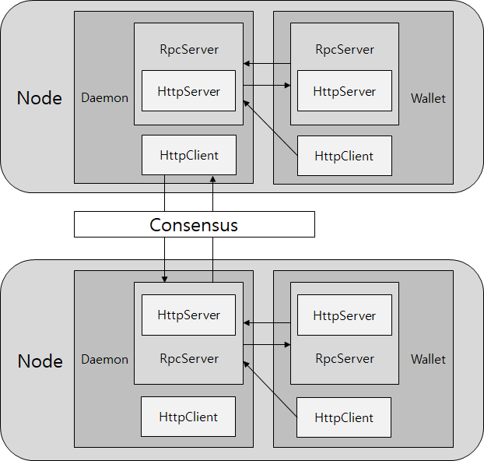
Researching : Paper
P2P Network Structure
Blockchain Network Structure
Hyunsoo Ha, Guik Jung, MyungHo Kim, YoungJong Kim, “An Implementation of Flexible Blockchain Framework(FBF) for Construct Own Blockchain Network”, KIISE, pp.729-731, 2018.

Slide 13
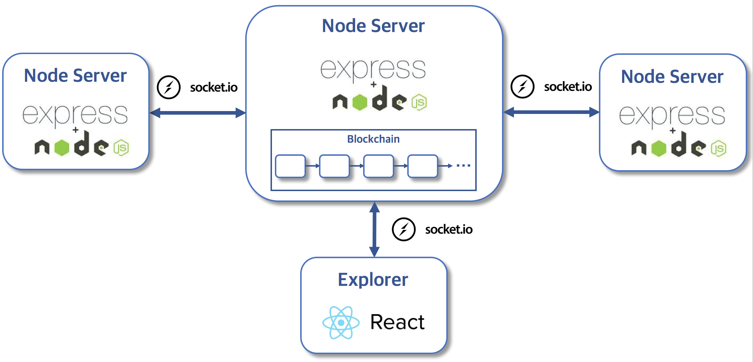
System structure - Blockchain
Notes:
소켓으로 p2p 통신을 하여 블록 생성 시 주변 노드들에게 전파
익스플로러도 소켓 io와 연결되어 블록 정보, 트랜잭션 정보 뿌려줌

Slide 14
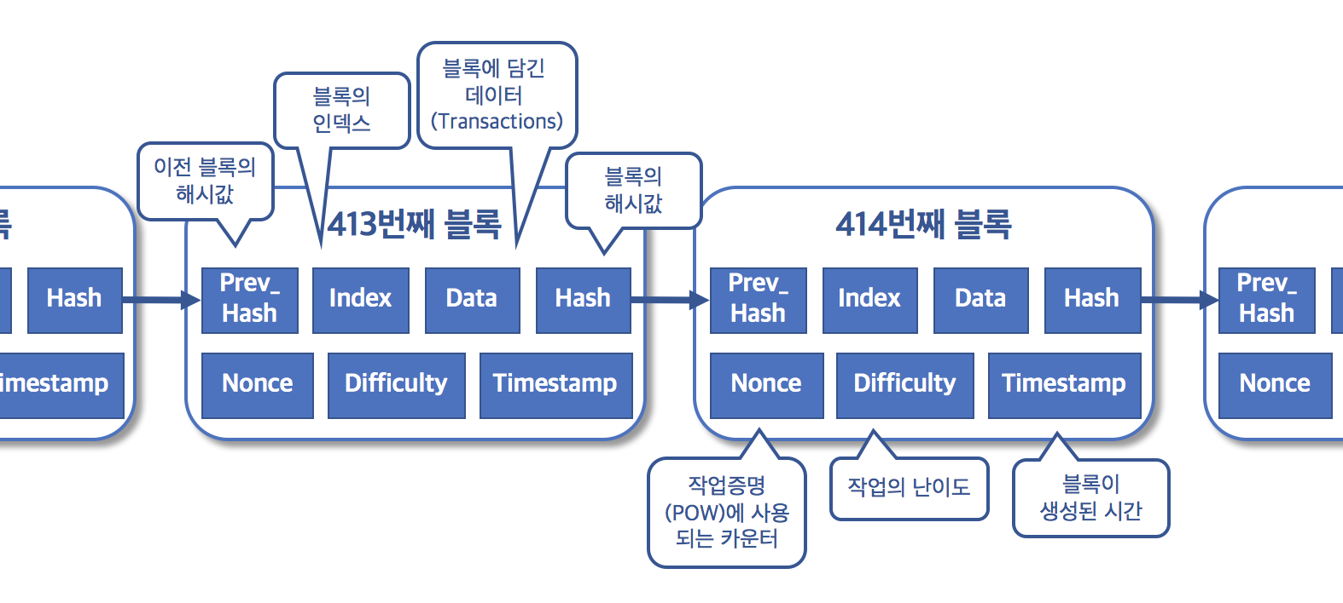
System structure - Block
Notes:
블록 구조

Slide 15
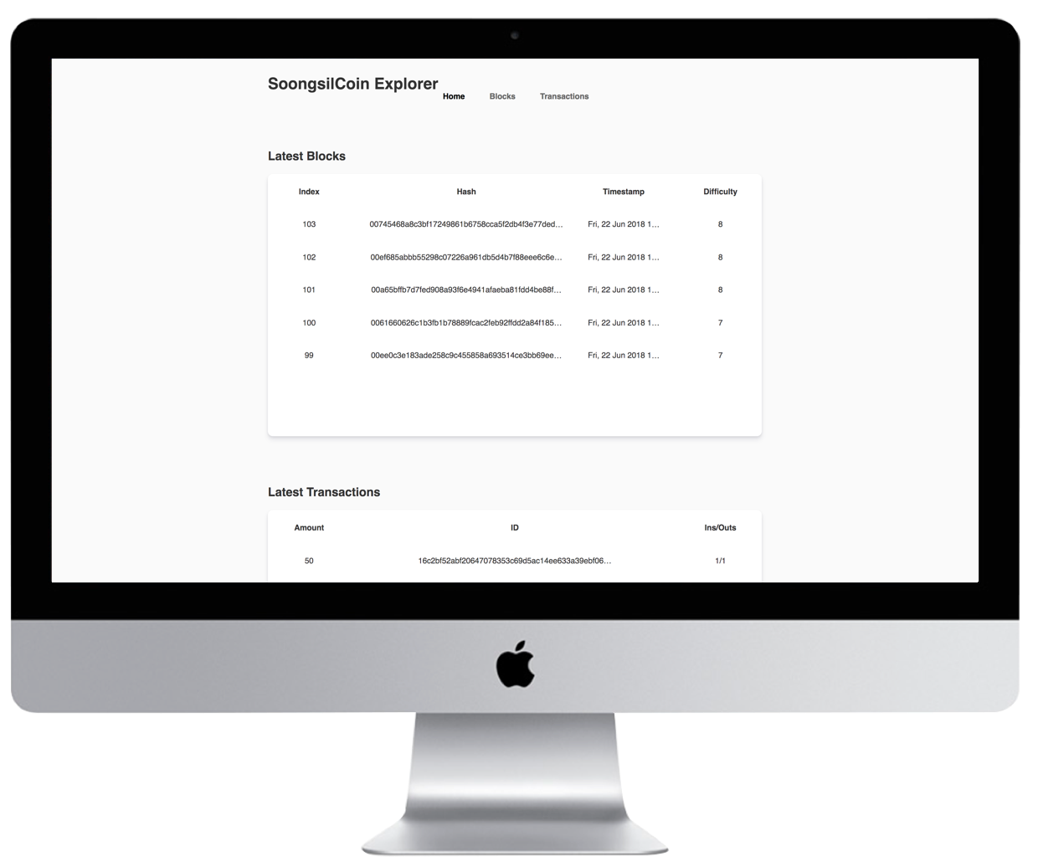
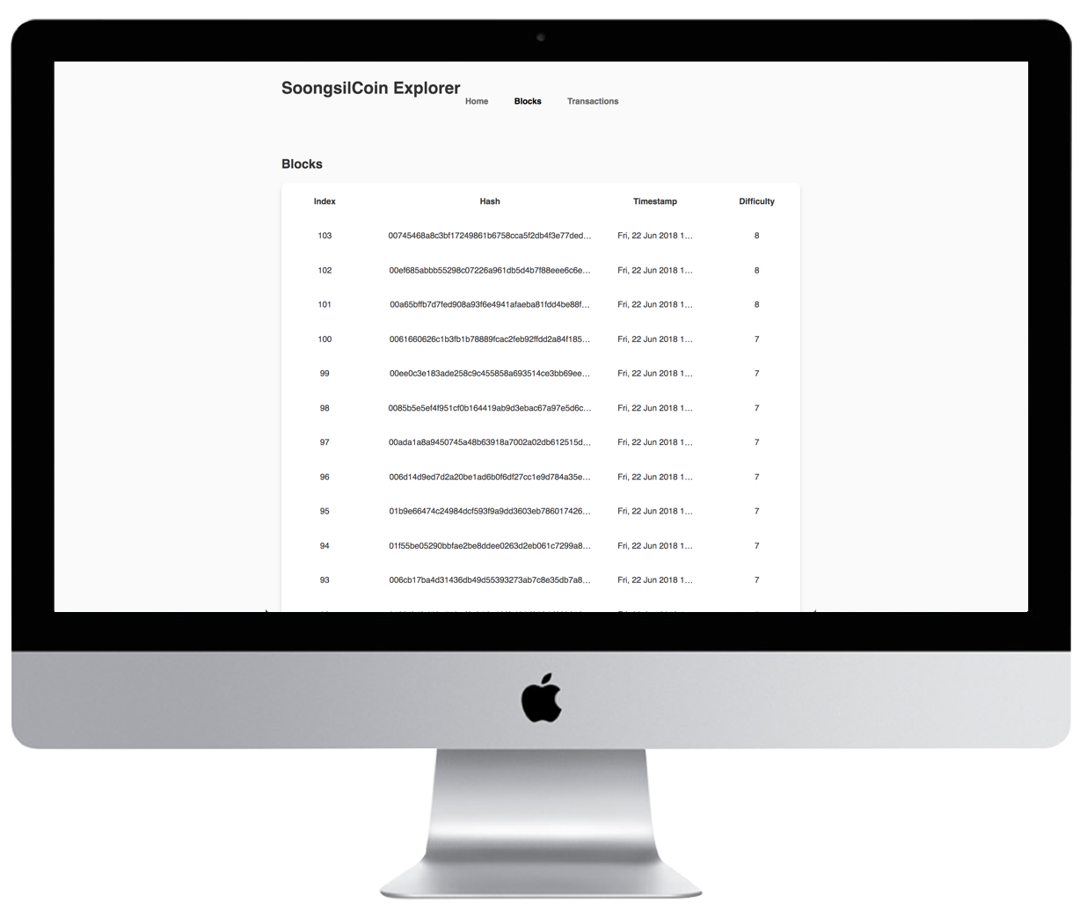
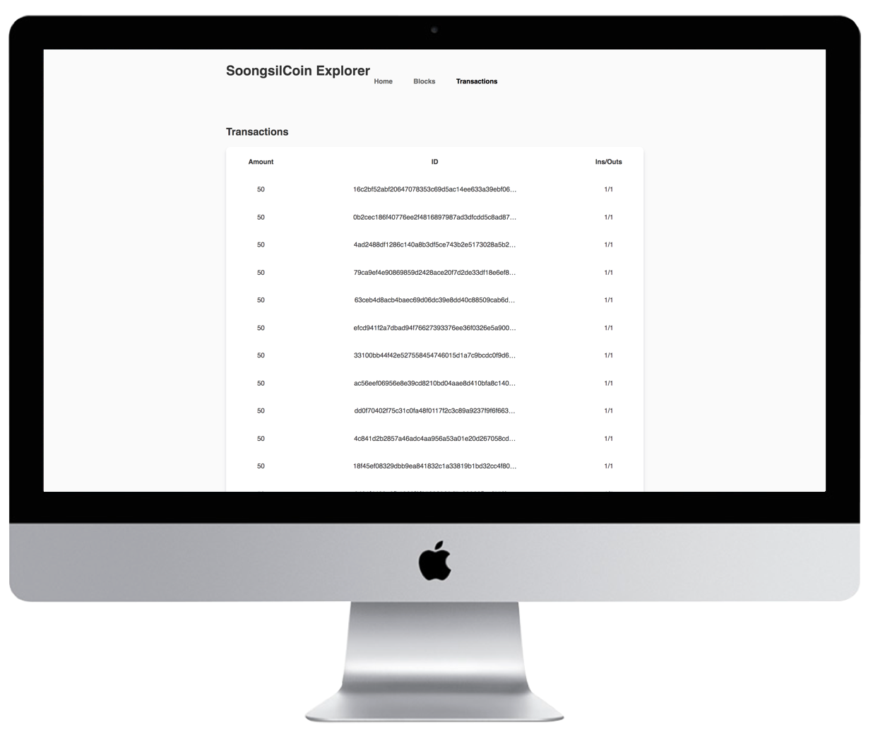
Demo - Explorer
http://ssu.sullivan.kr:3030
Recent
Blocks & Transactions
Blocks
Transactions

Slide 16
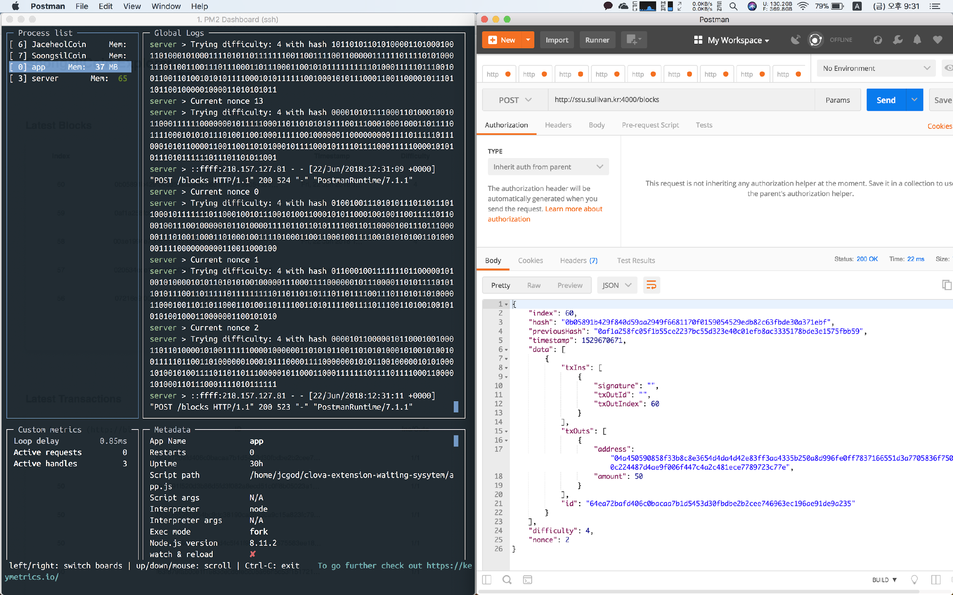
Demo - Consensus Algorithm (PoW)
Difficulty: 4

Slide 17
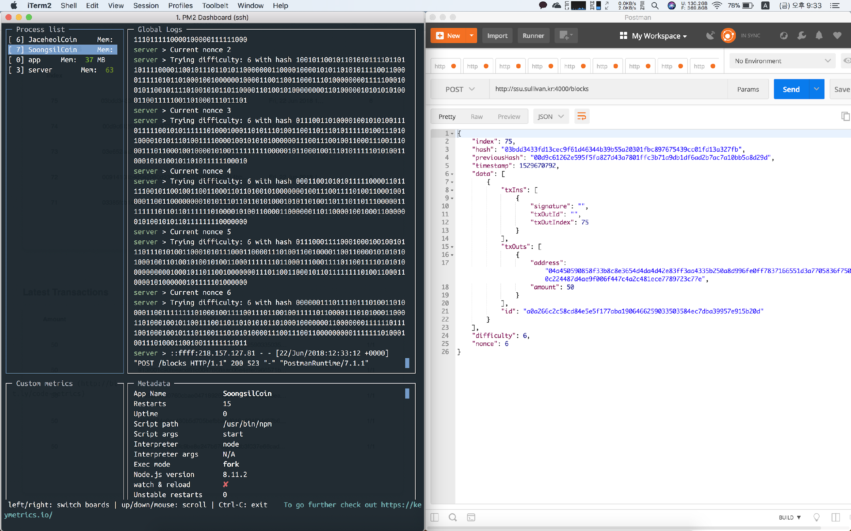
Demo - Consensus Algorithm (PoW)
Difficulty: 6

Slide 18
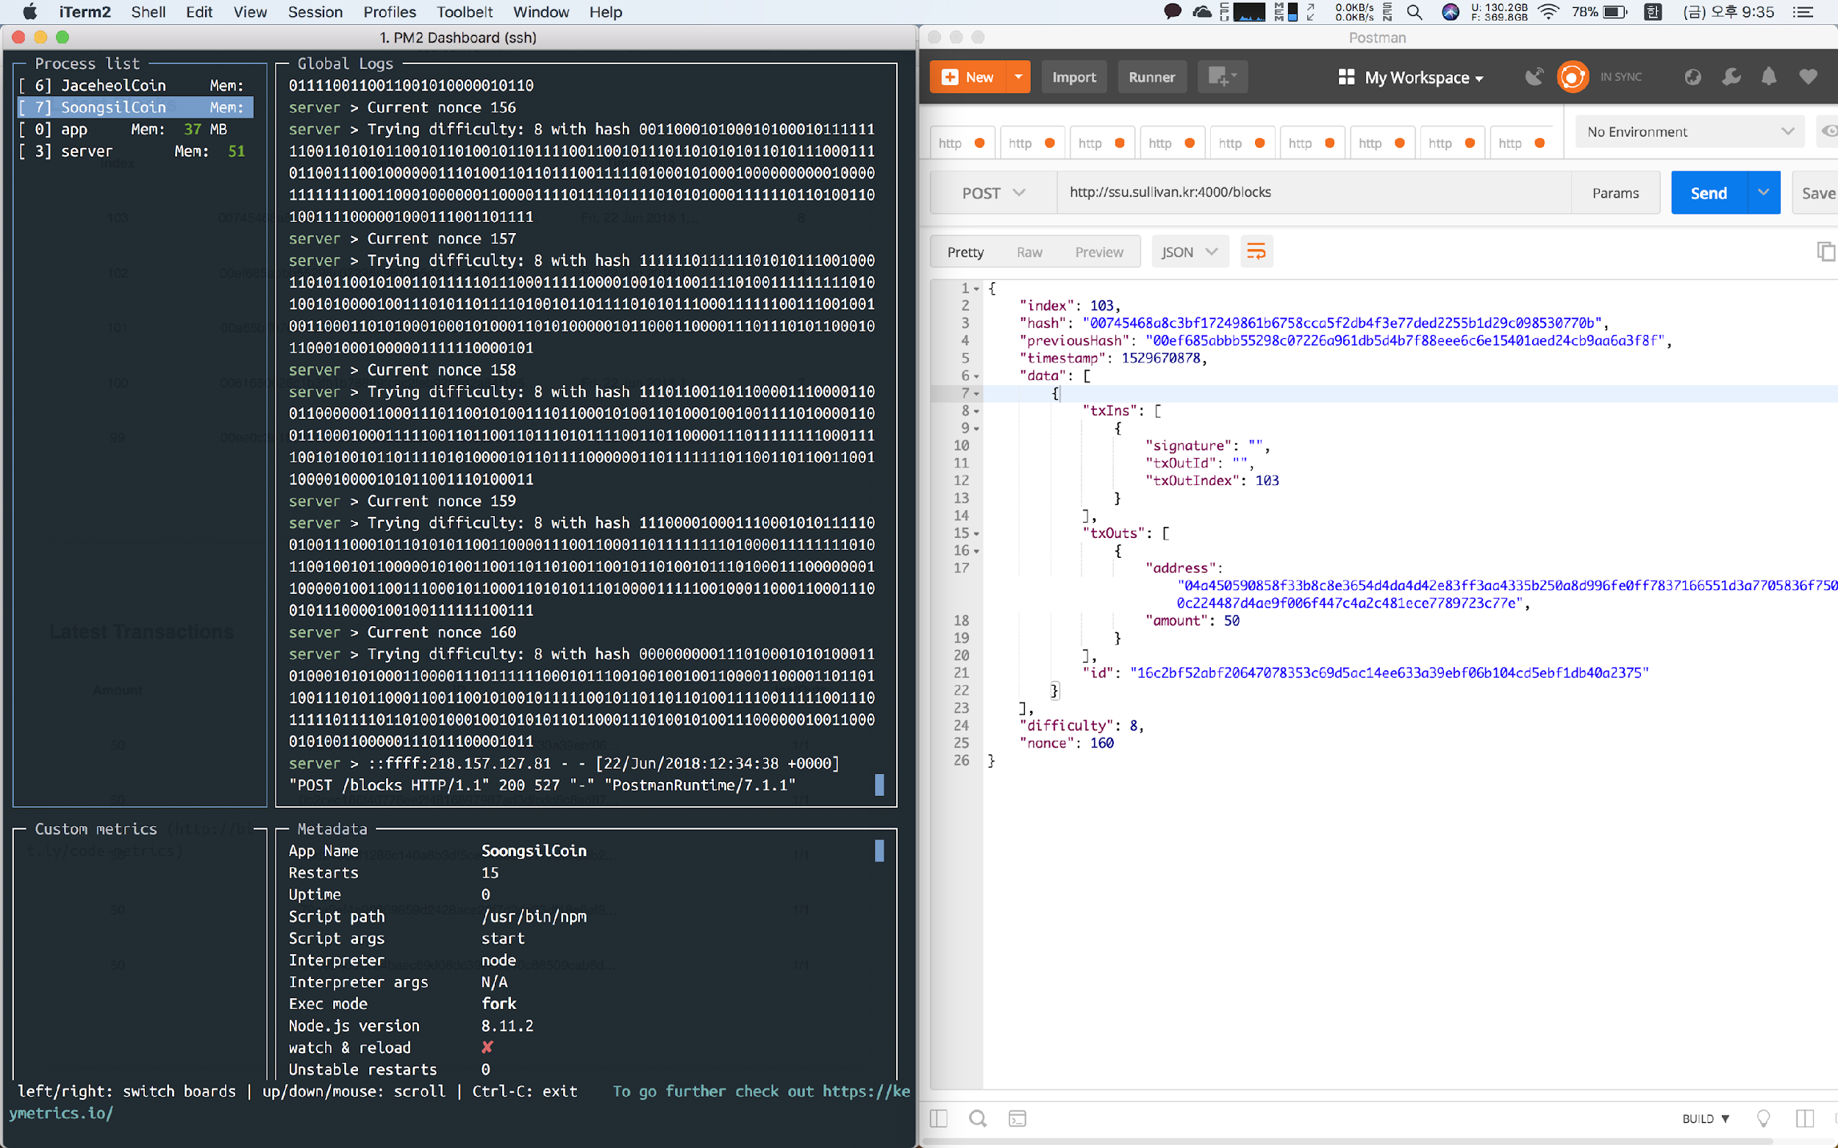
Demo - Consensus Algorithm (PoW)
Difficulty: 8

Slide 19
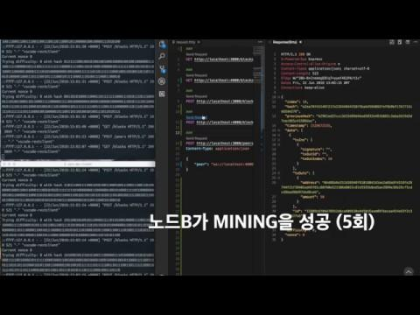
Demo - Video

Slide 20
Conclusion

Slide 21
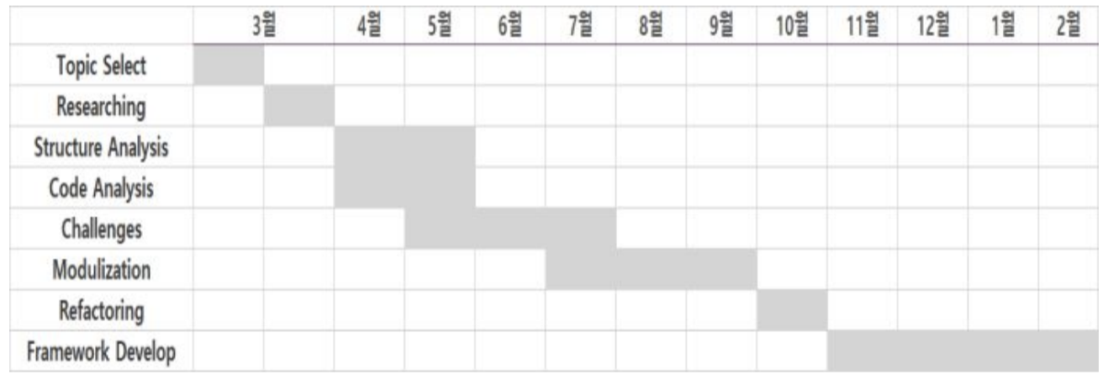
Roadmap

Slide 22

Expectation effect
By implementing lightweight blockchain as an open source project, Chainerator approached the goal of Capstone Design 1.

Slide 23

Challenges
Should try to make SoongsilCoin modularize to meet Chainerator’s final goal until Capstone Design 2.

Slide 24
Thank you

